Slide 1
FemInnovateX: Shaping Tomorrow's Tech
A. M.

Slide 2
Project overview
The product:
At FemInnovateX, we believe in a future where every girl has the opportunity to shape tomorrow's technology. Our mission is to bridge the gender gap in STEM (Science, Technology, Engineering, and Mathematics) and empower girls to become confident innovators in the world of AI and futuristic tech.
Project duration:
September 2023 – October 2023

Slide 3
Project overview
The problem:
Lila is a tech-savvy high school student in an underrepresented area
who needs a platform to fuel her curiosity, connect with peers in STEM, and bridge the resource gap
because she has a thirst for knowledge and big aspirations but does not feel empowered to shape her own future in the world of technology and innovation by her schools’ limited resources alone.
The goal:
Inspire girls to pursue careers in STEM and AI by providing engaging and comprehensive learning resources. Foster a strong global community of aspiring female innovators who support and mentor each other. Equip girls with the skills and knowledge they need to become leaders in the world of technology and science.

Slide 4
Project overview
My role:
CEO
Lead UX/UI Designer
Responsibilities:
User research
Wireframing
Prototyping
Pitching

Slide 5
User research
Personas
Problem statements
User journey maps
Understanding
the user

Slide 6
User research: summary
Our user research highlights a strong demand for the 'FemInnovateX: Shaping Tomorrow's Tech' mobile app among high school girls interested in STEM and AI education. Respondents expressed the need for accessible STEM resources and female mentorship, particularly in underrepresented areas with limited funding for STEM subjects. The app's mission to empower girls in STEM received a highly positive response, emphasizing its potential to bridge the resource gap and provide a sense of community. Users are enthusiastic about the prospect of engaging with the app's interactive free STEM courses and mentorship resources, validating its role in shaping the future of young girls in technology and innovation.

Slide 7
User research: pain points
1
2
3
4
Pain point
Pain point
Pain point
Pain point
Many users face restricted access to quality STEM education, hindering their career aspirations in technology and innovation.
Young girls with a passion for STEM often lack a supportive community of like-minded peers and mentors.
Gender disparities and biases in STEM fields can affect confidence and opportunities, creating hurdles to success.
The scarcity of accessible STEM mentors leaves many aspiring girls without guidance and support for their STEM journey.

Slide 8
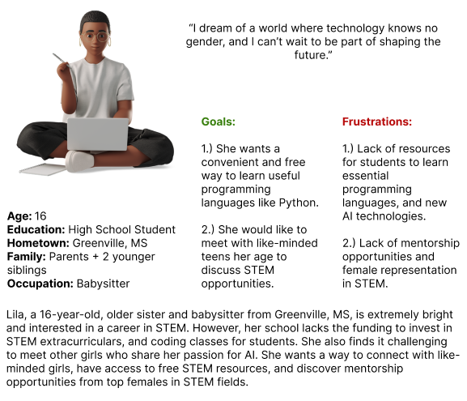

Slide 9
Persona: Lila
Goal: Access to free high-quality STEM and AI educational resources, connect with a likeminded community, and empowering female mentorship.
ACTION | Get app | Create Profile | Register for Courses | Sign-up for Meet-ups | Connect with Mentor
TASK LIST | Tasks A. Search app store B. Download app C. Open app | Tasks A. Click profile icon B. Enter in required information C. Verify email and ID | Tasks A. Open Catalog tab B. Browse courses C. Click free registration button | Tasks A. Click meet-up tab B. Filter calendar by location and availability C. Register for meet-up D. Verify ID | Tasks A. Click mentor tab B. View mentor profiles C. Write mentor of choice
FEELING ADJECTIVE | Curiosity searching for app Nervous downloading app Intrigue viewing app features | Excitement setting up new account Nervous entering in information over the web Relief when everything is verified | Excitement viewing all the courses available Indecisiveness deciding which ones to sign up for Relief the classes are free | Excitement viewing meet-up options Indecisiveness deciding when you can meet-up Gratitude there is a meet-up near you to sign-up for Relief the verification process was simple | Excitement mentorship opportunity Relief the message successfully sent Anticipation to see what they will respond
IMPROVEMENT OPPORTUNITIES | Connect with Alexa, or other voice activated assistant to make searching app store easier. | App utilizes screen magnifiers or screen readers, to be more accessible. | Important information in text that stands out against background for better visibility. | Facial identification, and valid ID required to register for meet-ups to prevent predators. | Notifications when mentors have written you back. User can adjust notification settings to fit their preference.

Slide 10
Paper wireframes
Digital wireframes
Low-fidelity prototype
Usability studies
Starting
the design

Slide 11
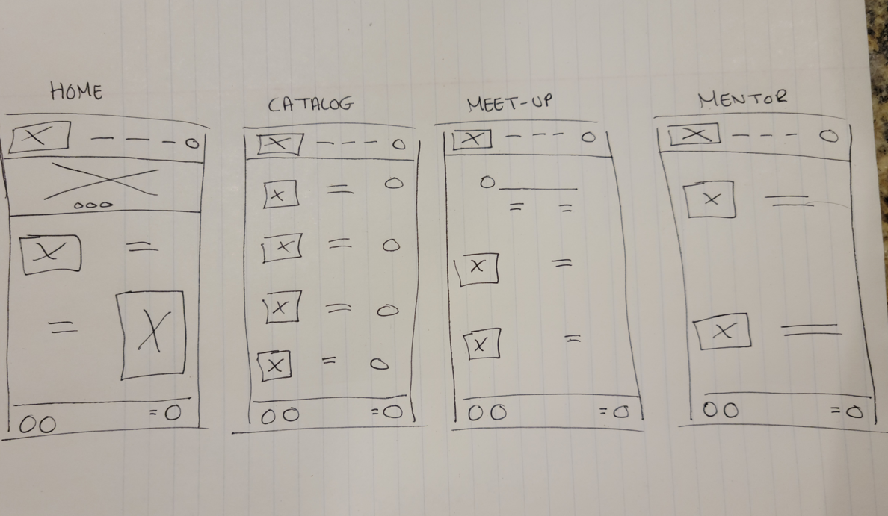
Paper wireframes
Goal: To create a basic outline of the FemInnovateX app’s features and functions for the Homepage, Catalog page, Meet-up page, and Mentor page.

Slide 12
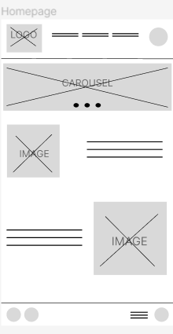
Digital wireframes
Goal: To create a more detailed wireframe that showcases functions and features for the homepage better.

Slide 13
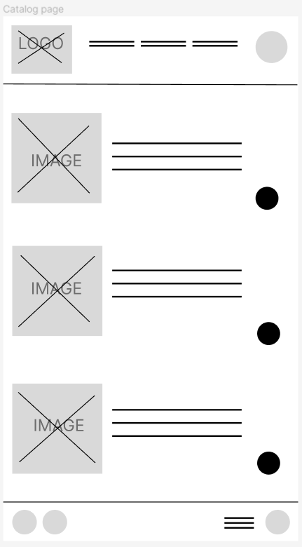
Digital wireframes
Helps users visualize course topic and code.
Goal: To create a more detailed wireframe that showcases functions and features for the catalog page better.
Allows users to add course to their basket.

Slide 14
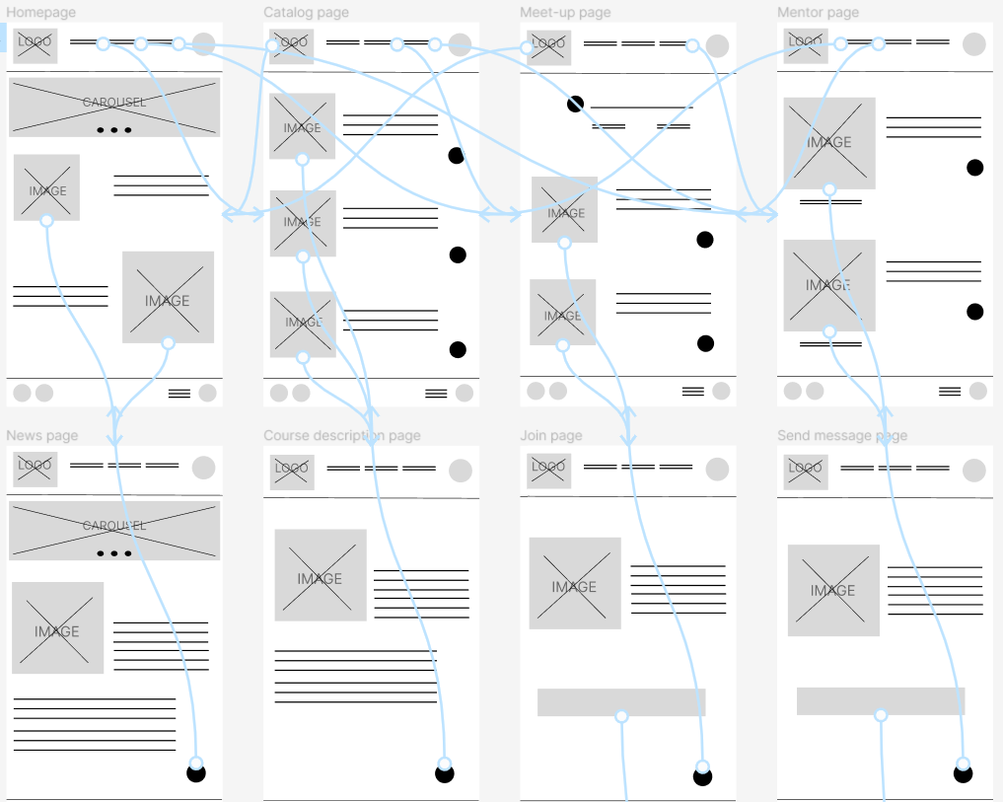
Low-fidelity prototype
Link: https://www.figma.com/file/LJm8w4mYl0jKxCIfEajzDL/Digital-Wireframes?type=design&node-id=0%3A1&mode=design&t=gTyT4sNVCp9gfxGT-1
Description:
Interactive functions and features in the FemInnovateX mobile app.

Slide 15
Usability study: findings
Round 1 findings
Round 2 findings
Users were frustrated by the lack of a filters on the catalog page. It took too long to scroll through all the courses offered on the catalog page and users would love interest in the product.
Users would like a confirmation page to know for certain that their message was sent and have the option to set up notification settings, so they know if the mentor has responded.

Slide 16
Refining
the design
Mockups
High-fidelity prototype
Accessibility

Slide 17
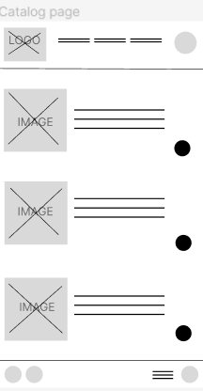
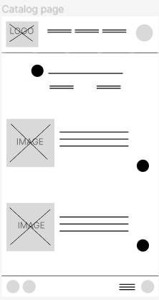
Mockups
Before usability study
After usability study
Before the usability study users were frustrated by the lack of a filter button on the catalog page.

Slide 18
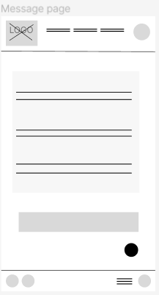

Mockups
Before usability study
After usability study
Before the usability study users mentioned they would like an additional confirmation page to know for certain that their message was sent.

Slide 19
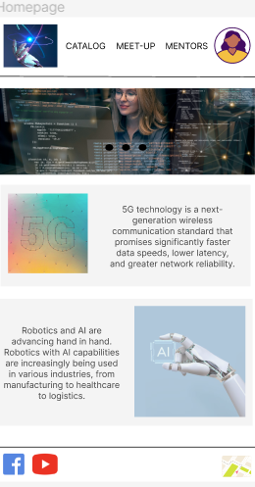
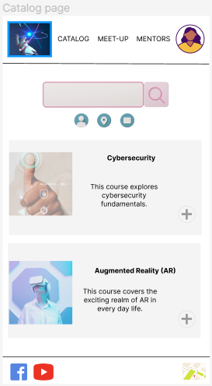
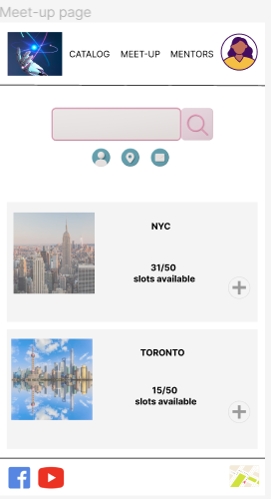
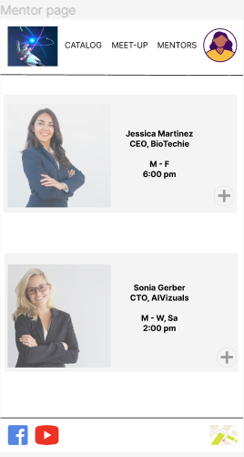
Mockups

Slide 20
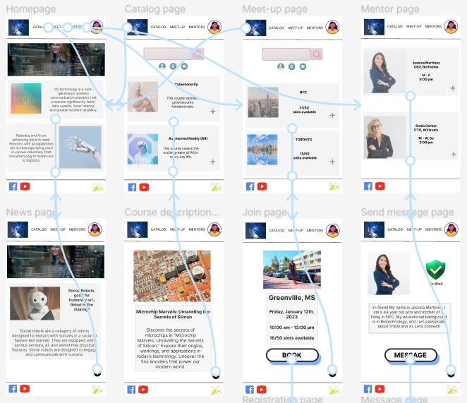
High-fidelity prototype
Link: https://www.figma.com/file/RWkTMuhQ4Sz0llrALLMqa0/High-Fidelity?type=design&node-id=0%3A1&mode=design&t=wTrrvhUFx8wCeLj8-1

Slide 21
Accessibility considerations
1
2
3
Ensure that the app is compatible with screen readers like VoiceOver (iOS) and TalkBack (Android). This means providing meaningful labels and descriptions for all user interface elements, including buttons, images, and text fields. It's crucial that users with visual impairments can navigate the app, understand product descriptions, and make purchases easily through speech output.
Ensure that users can navigate the app and perform essential functions using both touch gestures and keyboard input. Some users may have mobility impairments that prevent them from using touch screens. Make sure all features are accessible via keyboard shortcuts and ensure that interactive elements are large enough to be easily tapped or selected by users with limited dexterity.
Provide options for users to adjust text size, color contrast, and font settings within the app. Some users may have low vision or color blindness, so offering customizable settings can help them read content and interact with the app more comfortably. This includes the ability to increase font size, change color themes, or enable high contrast modes.

Slide 22
Going forward
Takeaways
Next steps

Slide 23
Takeaways
Impact:
FemInnovateX empowers young girls, like Lila, by providing accessible STEM education and fostering connections within a supportive network, bridging the gender gap in technology and shaping a brighter future for the next generation of innovators.
What I learned:
During the development of 'FemInnovateX,' I learned that there's an immense and underserved appetite among young girls, particularly in underrepresented regions, for high-quality STEM education and a supportive community. This journey highlighted the significance of accessible resources and mentorship in empowering these aspiring female innovators. Moreover, it reinforced the importance of inclusive technology to bridge the gender gap in STEM and pave the way for a brighter, more equitable future in technology and innovation.

Slide 24
Next steps
1
2
3
Proceed to the development phase, transforming the app design into a functional product. Conduct rigorous testing to ensure it functions smoothly and is user-friendly. This step involves coding, debugging, and refining the app's features.
Begin outreach efforts to connect with schools, organizations, and communities in underrepresented areas to promote the app. Establish partnerships with local educational institutions and nonprofits to enhance its reach and effectiveness.
Launch the app to a limited user group for early feedback and make necessary adjustments based on their input. This iterative process helps fine-tune the app's features, content, and user experience, ensuring it meets the needs of its target audience.

Slide 25
Insert a few sentences summarizing the next steps you would take with this project and why. Feel free to organize next steps in a bullet point list.
Let’s connect!
Thank you for taking the time to review the FemInnovateX mobile app UX design. I hope you found it informative, valuable, and inspiring. If you have any comments, questions, or concerns, please feel free to reach out. You can contact me at (561) 628-3137 or via email at alisonmazzarella@gmail.com. Have a fantastic day!

Slide 26
Thank you!

